Slide 1

PROJECT PRESENTATION
“ONLINE BOOK STORE”
Project Guide: Presented By :
Mr. Kashinath Patil Suruchi Patil(219206)
Diksha Malviya (219059)

Slide 2
Introduction
The online bookstore system based on the principle of provides service and facility to users to buy the book online.
The main aim of this system is to create a website where a customer can visit and buy books online and delivered to his/her doorsteps.
The online book store has some functions, by which customer can register and buy some books.
System administrator responsible for managing books and category.
Using the system, customer can buy book from anywhere ultimately saves time and efforts.

Slide 3
Need of System :
In Existing system , customer need to visit book store . Select the types of books and finding the books as per requirement is time consuming and tedious task .
Online book store broke the management mode of traditional bookstore provide facility to customer to buy the book from anywhere which ultimately saving time and efforts.

Slide 4
Admin Functionality :
Admin is responsible for managing books and category.
Admin can add the category.
Admin can add the book , it's price ,image , description and quantity.
Admin can update the details any time.
Admin can see the list of books.

Slide 5
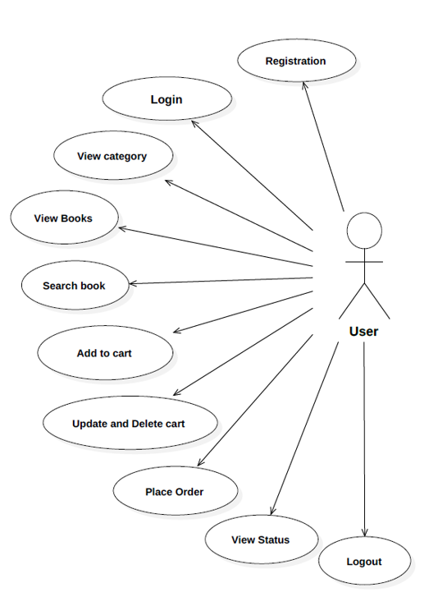
Use –case diagram : Customer

Slide 6
Technology Used :
Front – End : ReactJS , Html , CSS ,Bootstrap.
Back-End : Spring Boot REST API .
Database : MySQL .

Slide 7
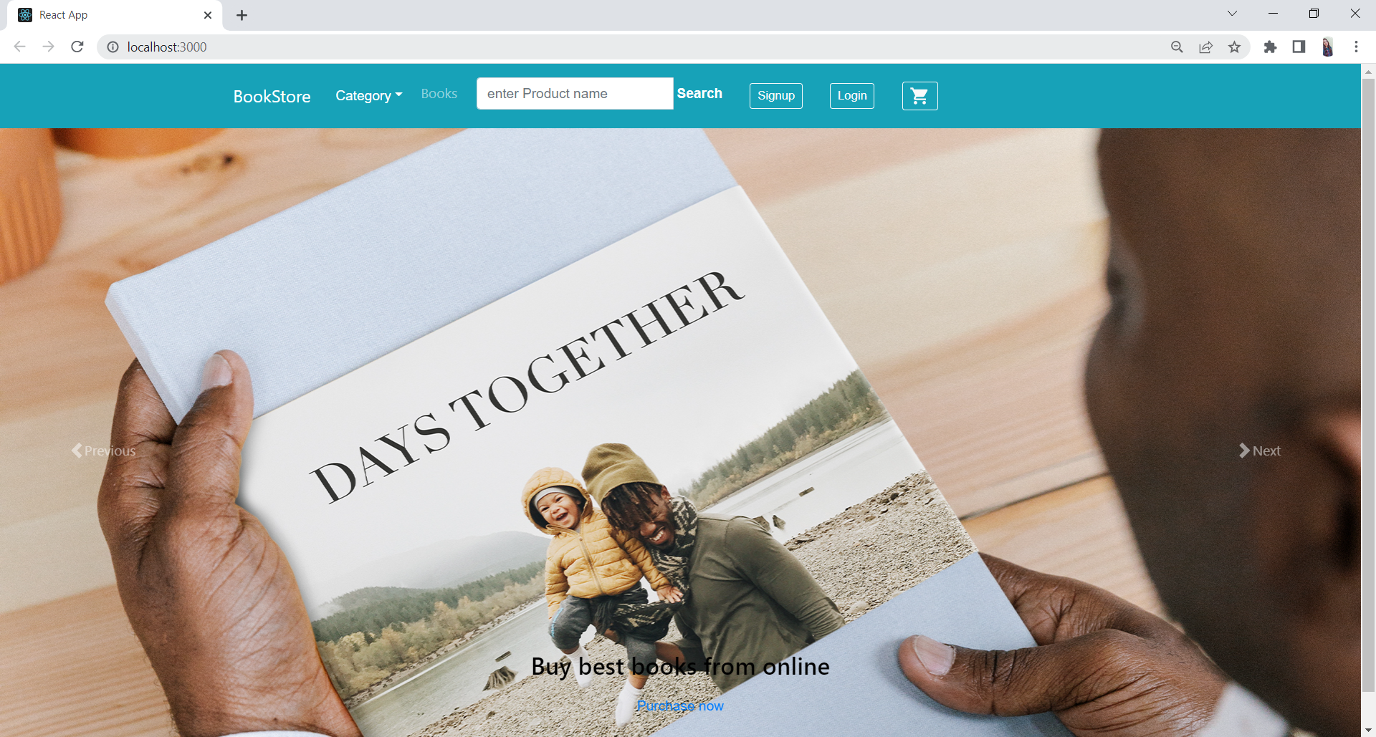
Screenshots :

Slide 8
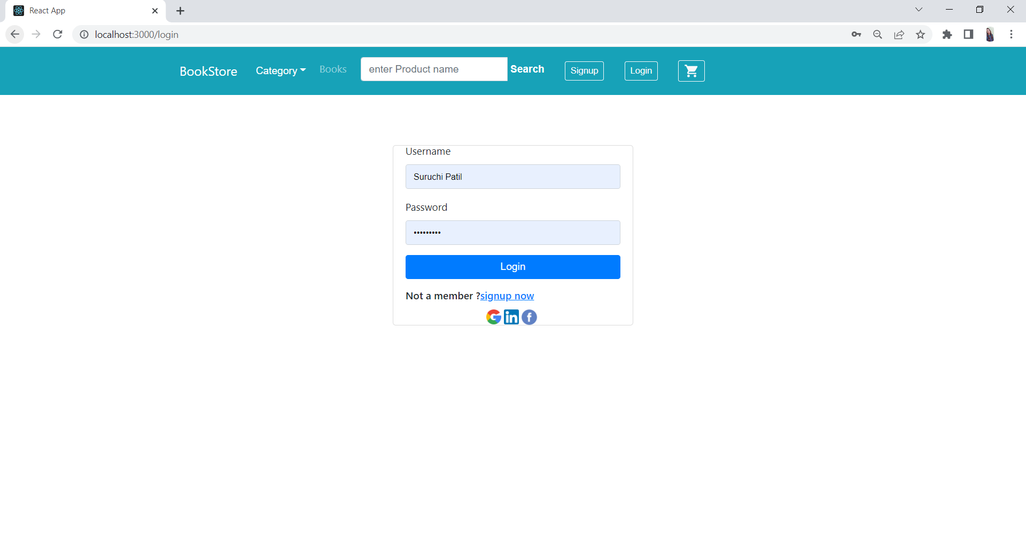
Login :

Slide 9
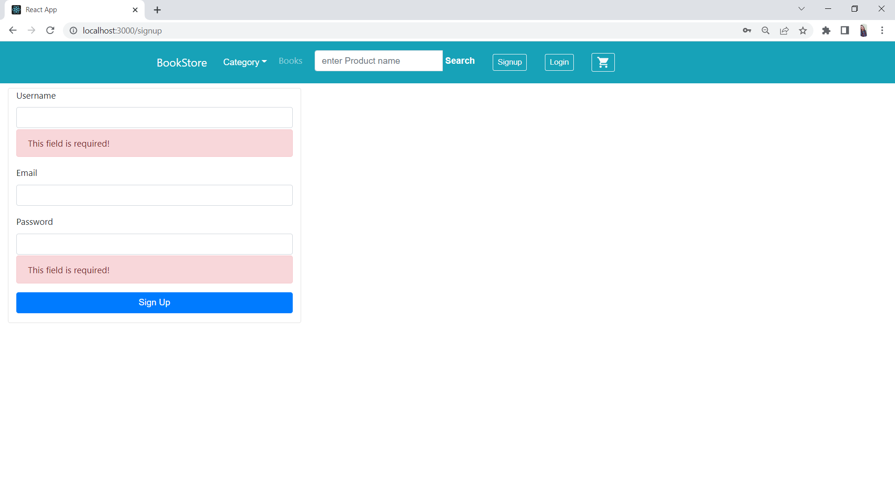
Register:

Slide 10
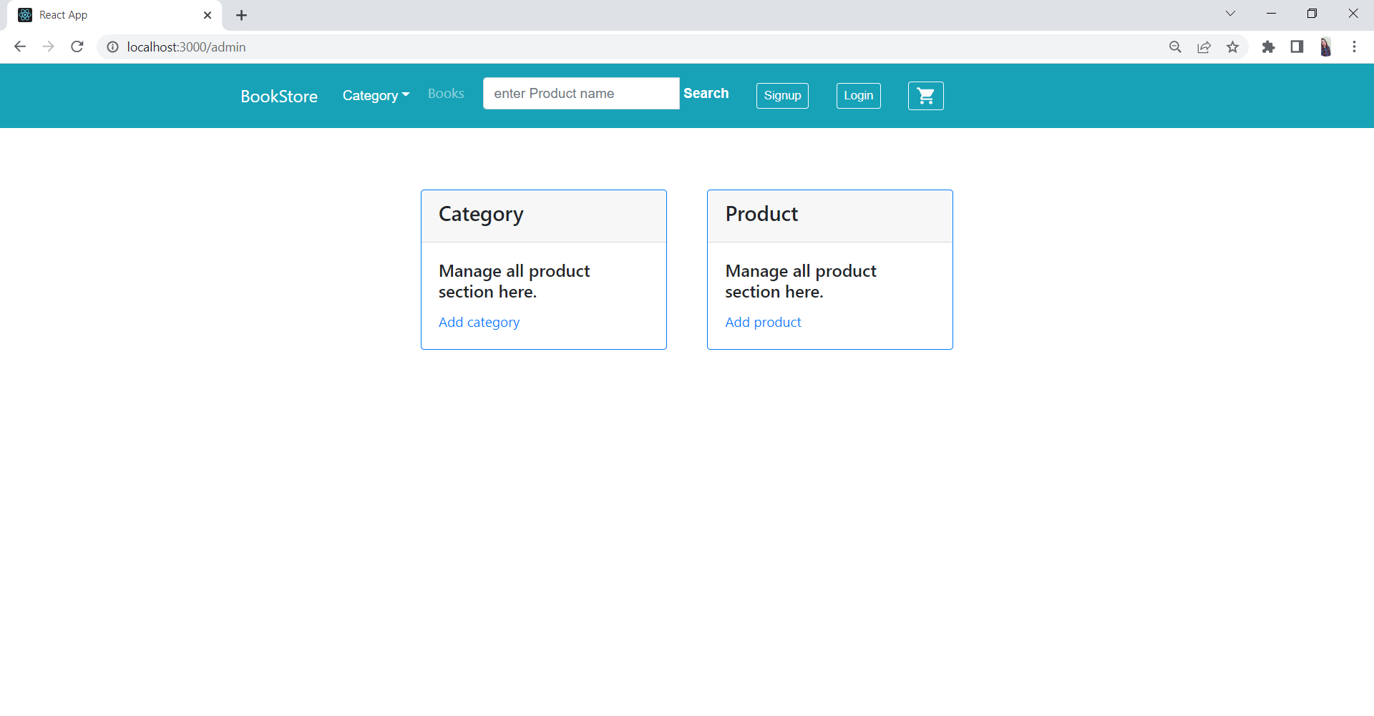
Admin :

Slide 11
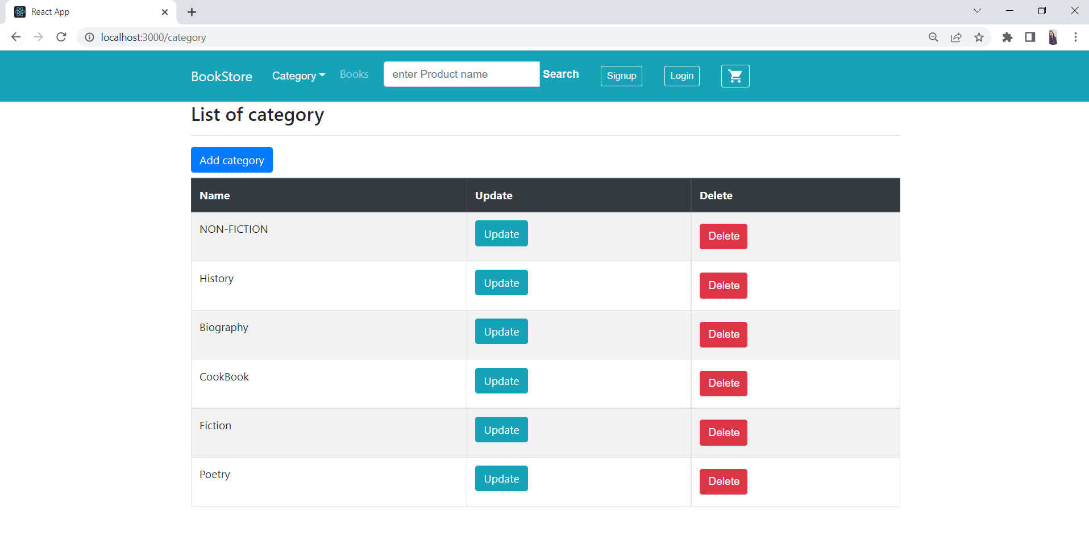
Admin –Category:

Slide 12
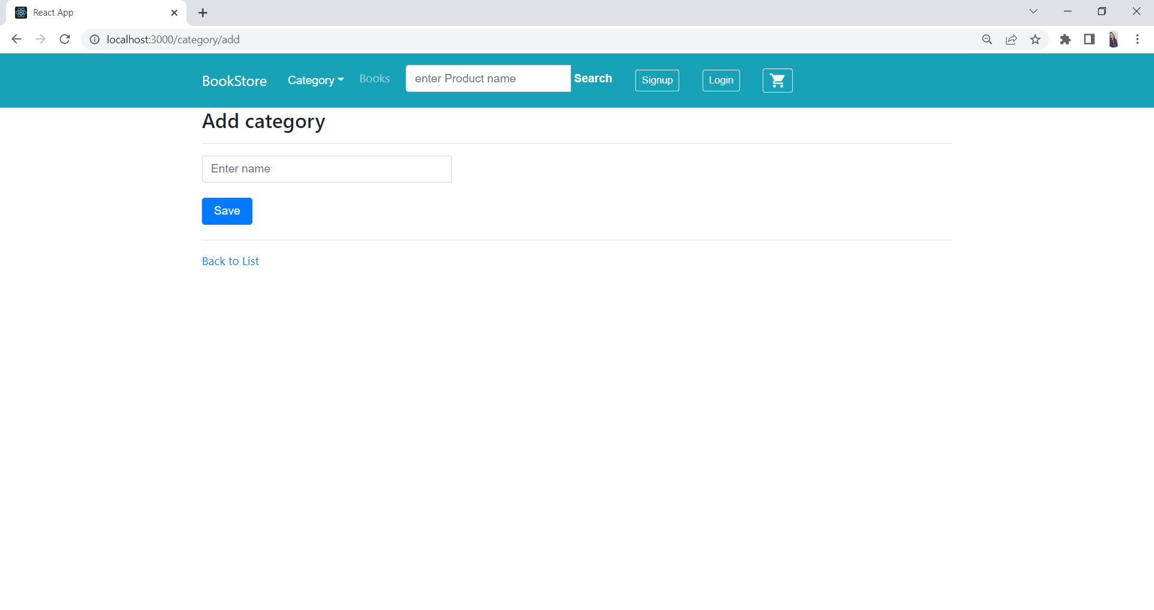
Add / Update Category:

Slide 13
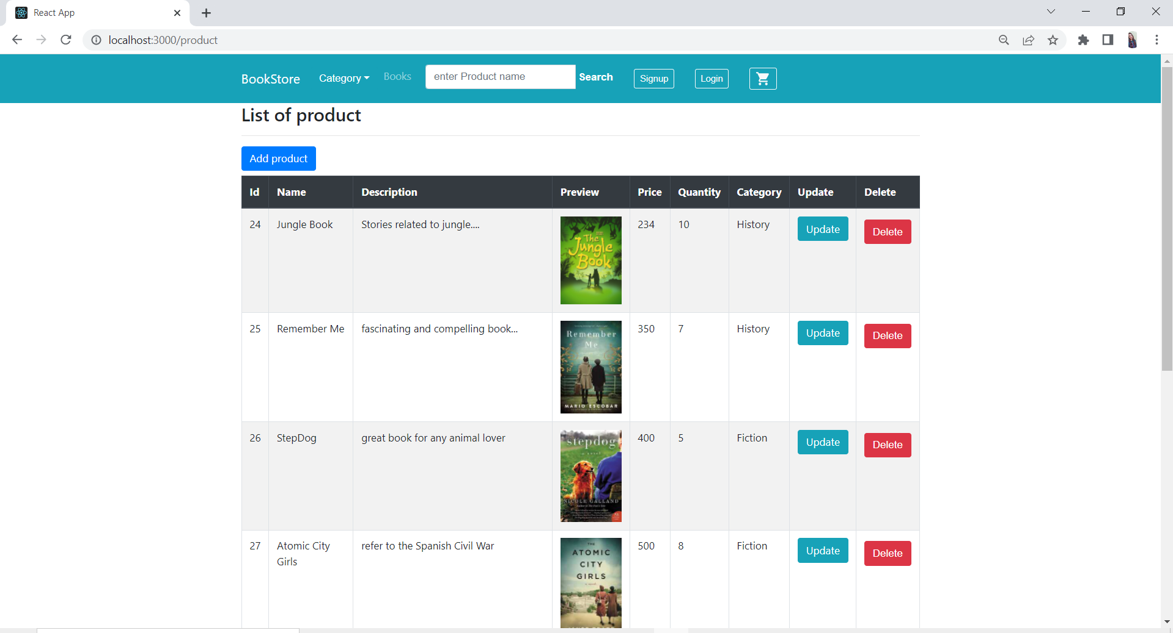
Admin –product:

Slide 14
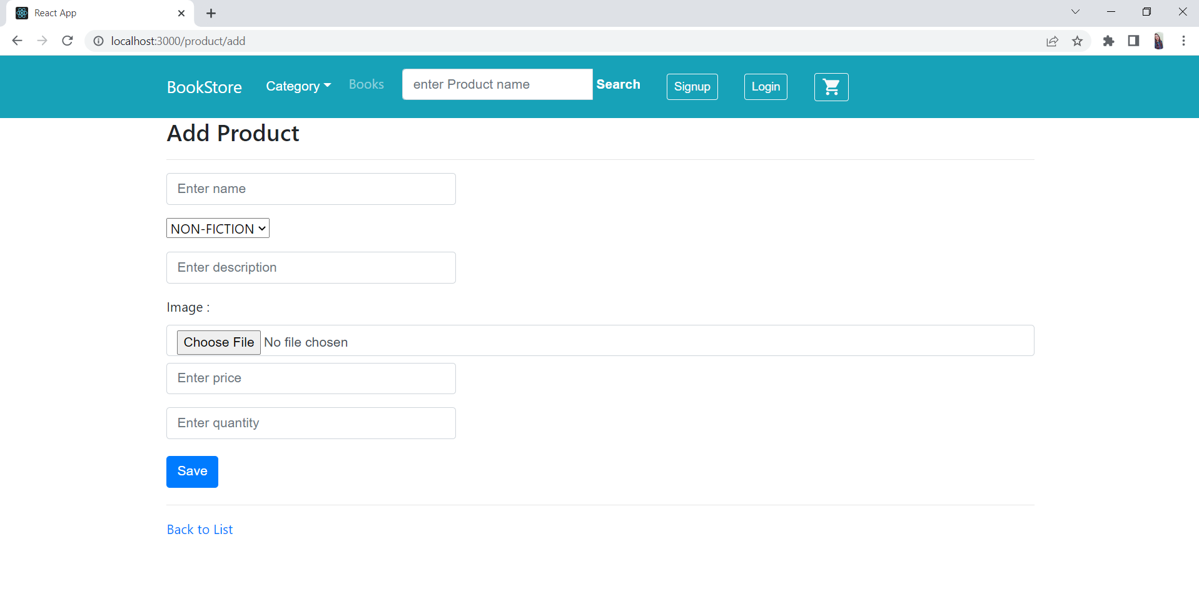
Add / Update product:

Slide 15
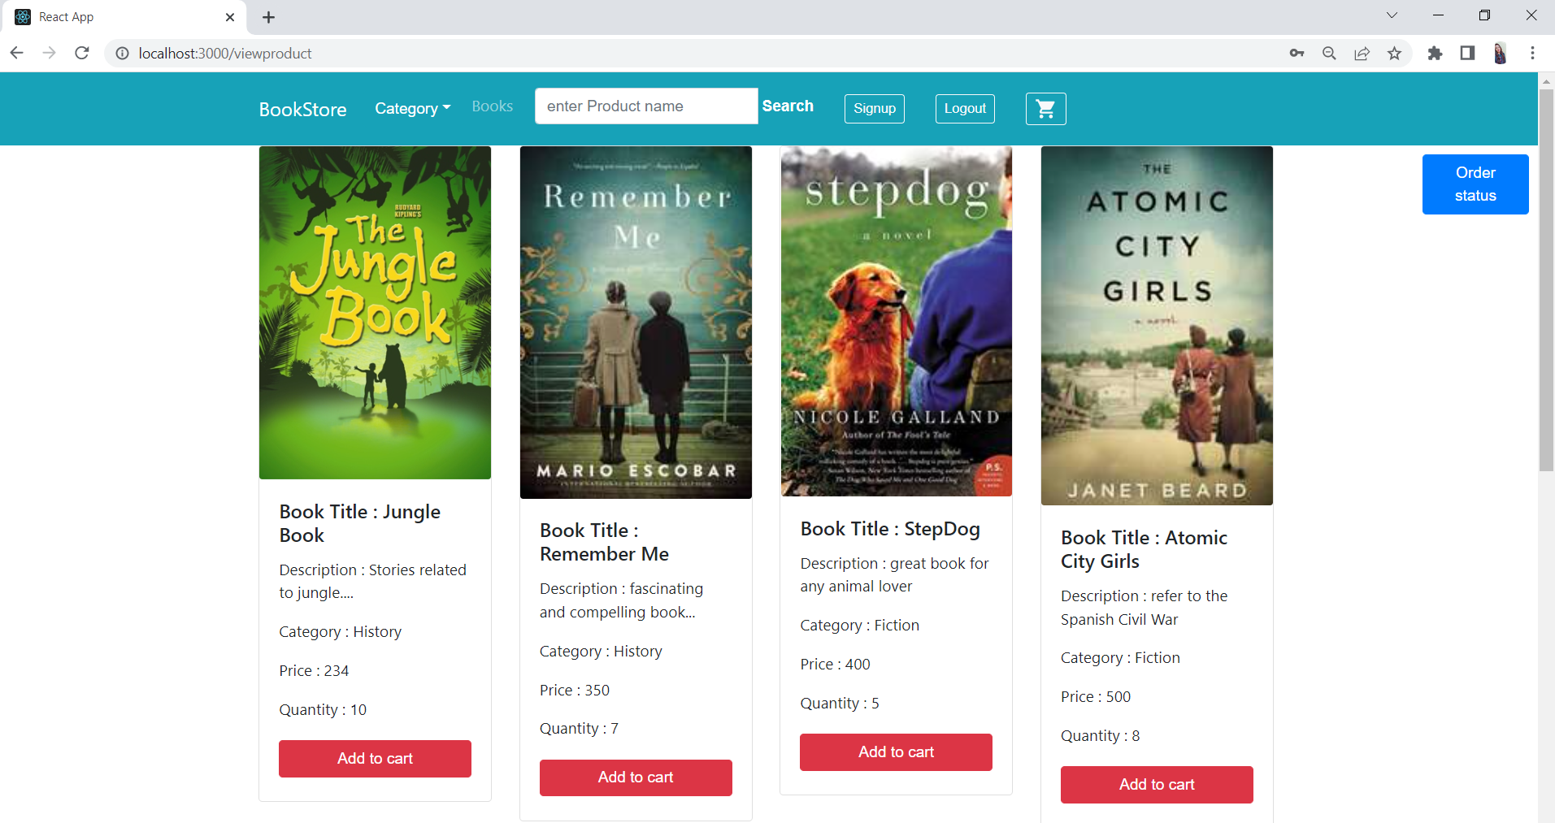
User- View product :

Slide 16
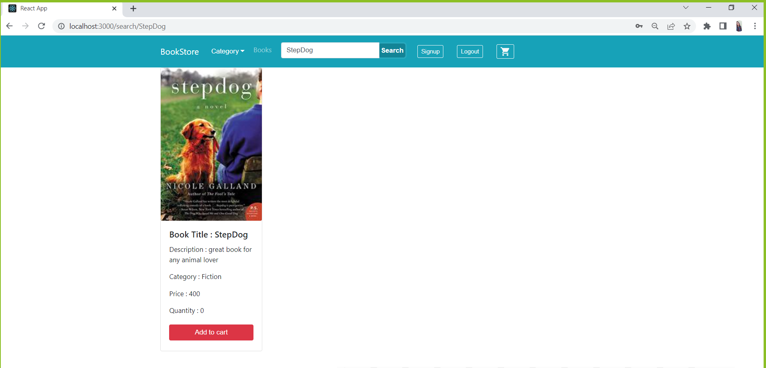
User- Search by title:

Slide 17
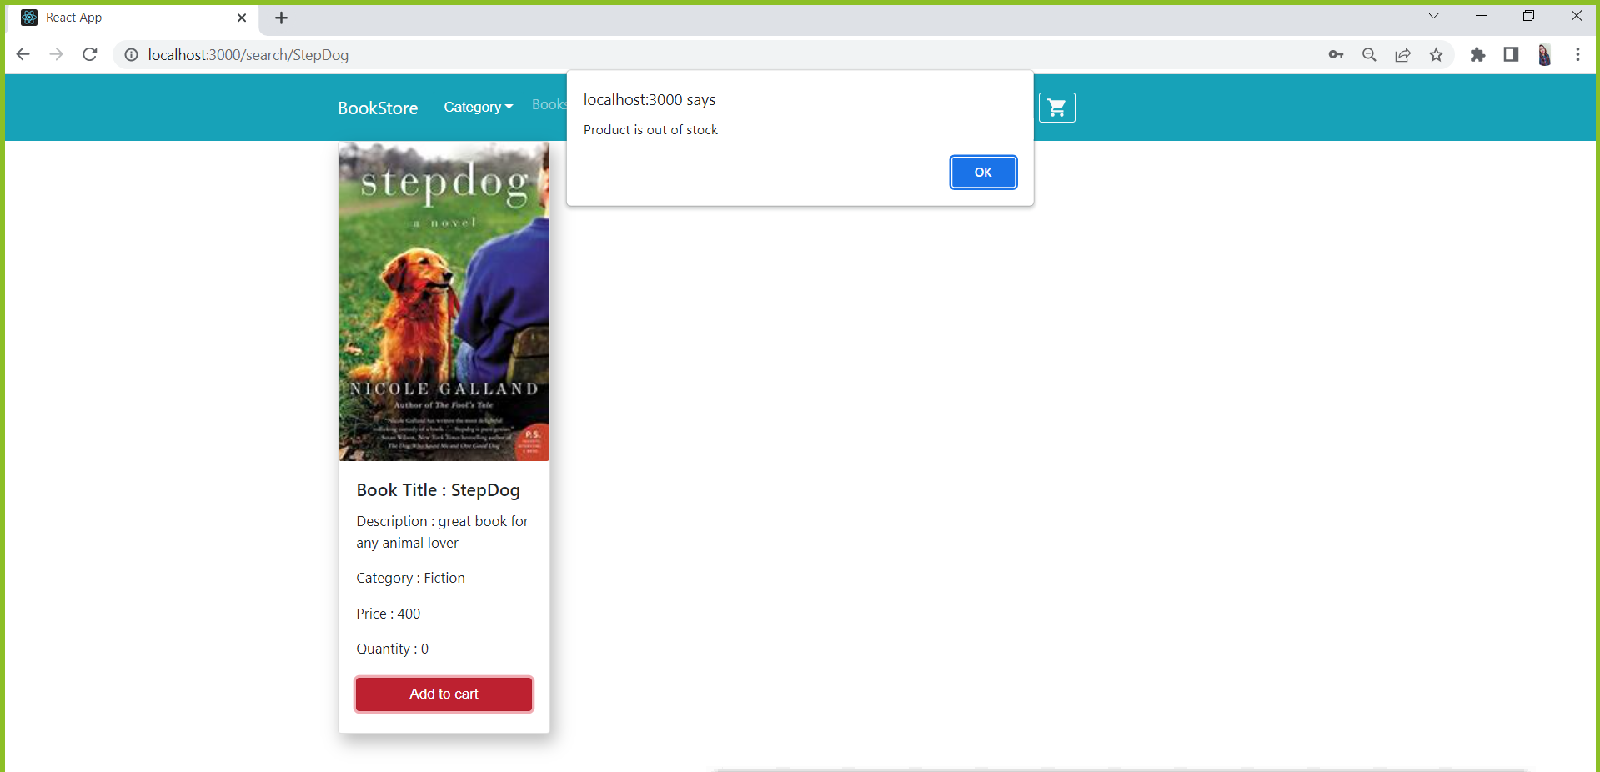
User- Add to cart :

Slide 18
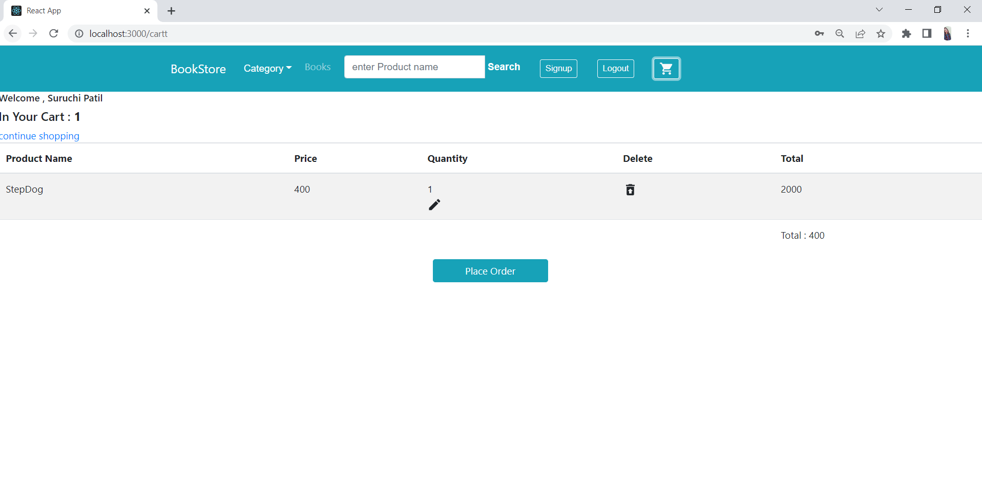
User- cart :

Slide 19
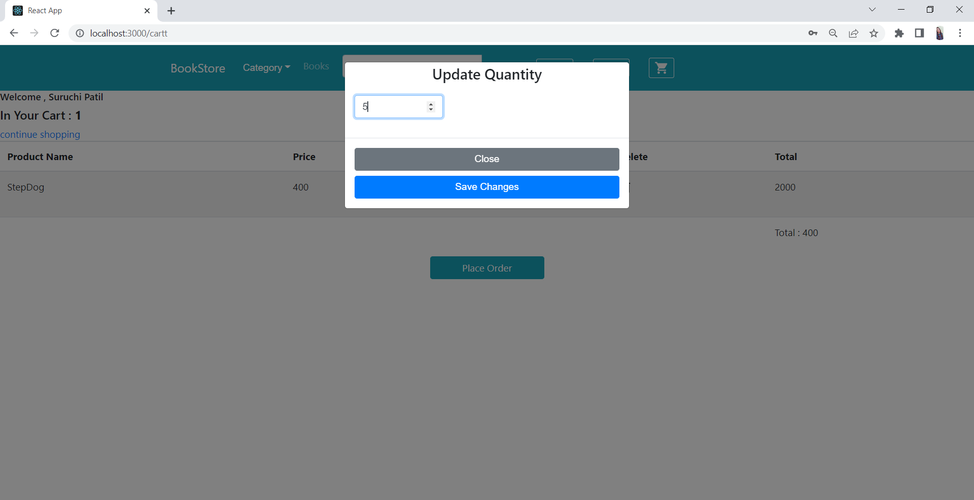
User- cart update:

Slide 20
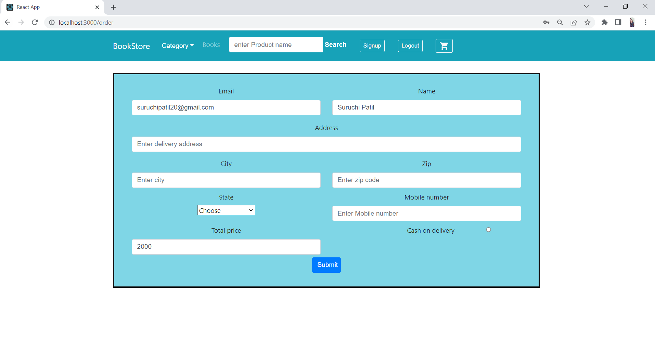
User- Order:

Slide 21
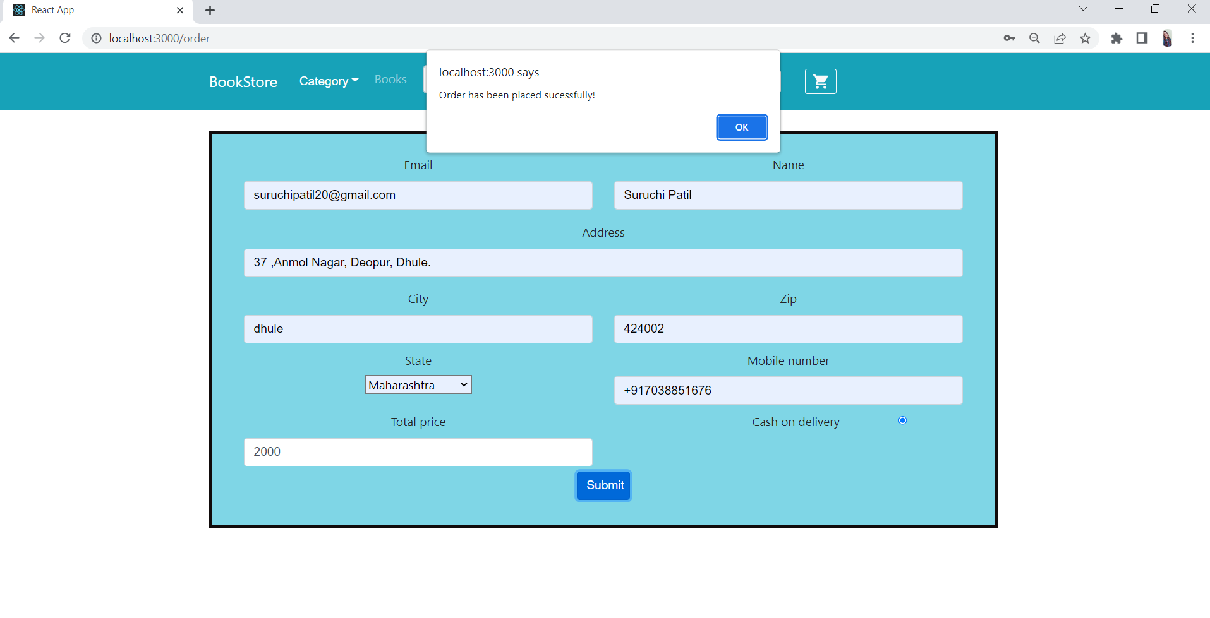
Place Order :

Slide 22
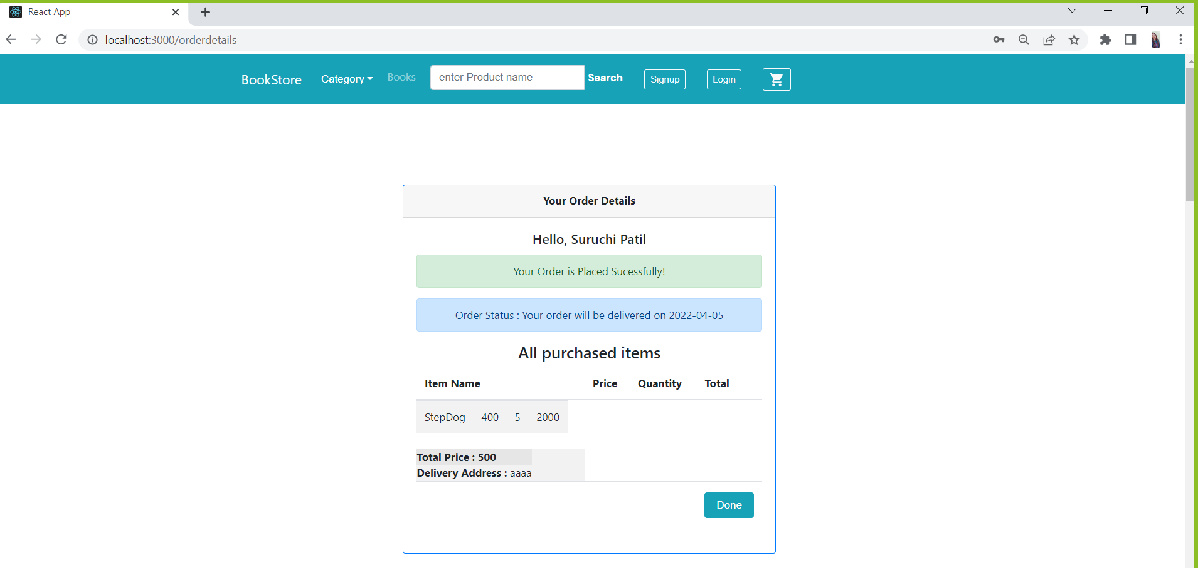
Order-Status :

Slide 23
Conclusion :
Online Book Store the customer can purchase books online.
It is mainly different from the traditional physical bookstores, to overcome a series of physical bookstores limited
variety, fixed location, limited space and other issues.
online book store website is user-friendly.

Slide 24
Future scope:
As for other future developments :-
User can buy some subscription plan for accessing some advanced functionality such as reading books online.
User need to pay some amount and then only he can enjoy 'read the book online' feature.
A Payment gateway which is a part of the microservice.

Slide 25
References :
1 .https://spring.io/projects/spring-data-jpa
2 .https://www.bezkoder.com/spring-boot-jwt-authentication/
3 .https://docs.spring.io/spring
framework/docs/current/reference/html/

Slide 26


